Slide 1
Exception Handling!
By: Iman Khani Jazani
AI and Data Specialist, Business Developer | AiHum
Adjunct Professor | Sharif University of Technology
Senior Data Scientist, Community builder | Adin

Slide 2
Last Lecture
Short Presentations
Review the last lecture
Searching and sorting applications
Introduction to searching and sorting algorithms
Application of Programming in the Digital Age!

Slide 3
Today
Short Presentations
Review the last lecture
Do you remember…
Talking about exceptions and errors from Dr. Nowzari’s slide…
Application of Programming in the Digital Age!

Slide 4
Together
Send your feedback about the class whenever you want!

Slide 5
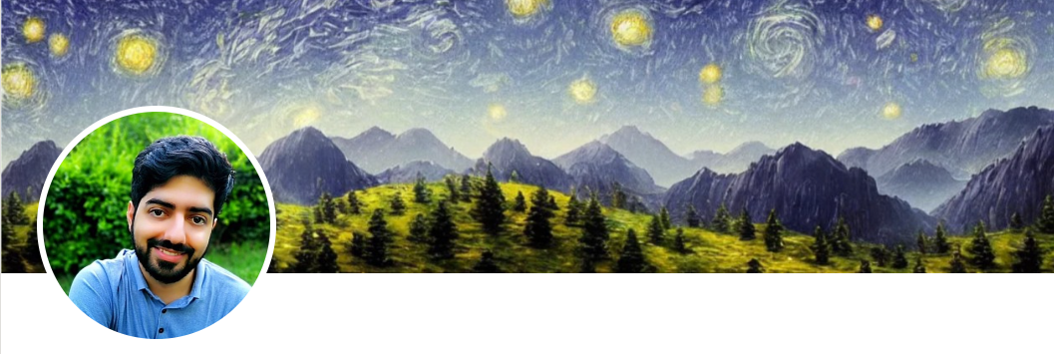
Contact me
Gmail: ImanKhaniJazani@gmail.com
LinkedIn: https://www.linkedin.com/in/ImanKhaniJazani/
Telegram: @IKJ1992

Slide 6
Short Presentations

Slide 7
Review the Last Lecture from Stony Brook University Course

Slide 8
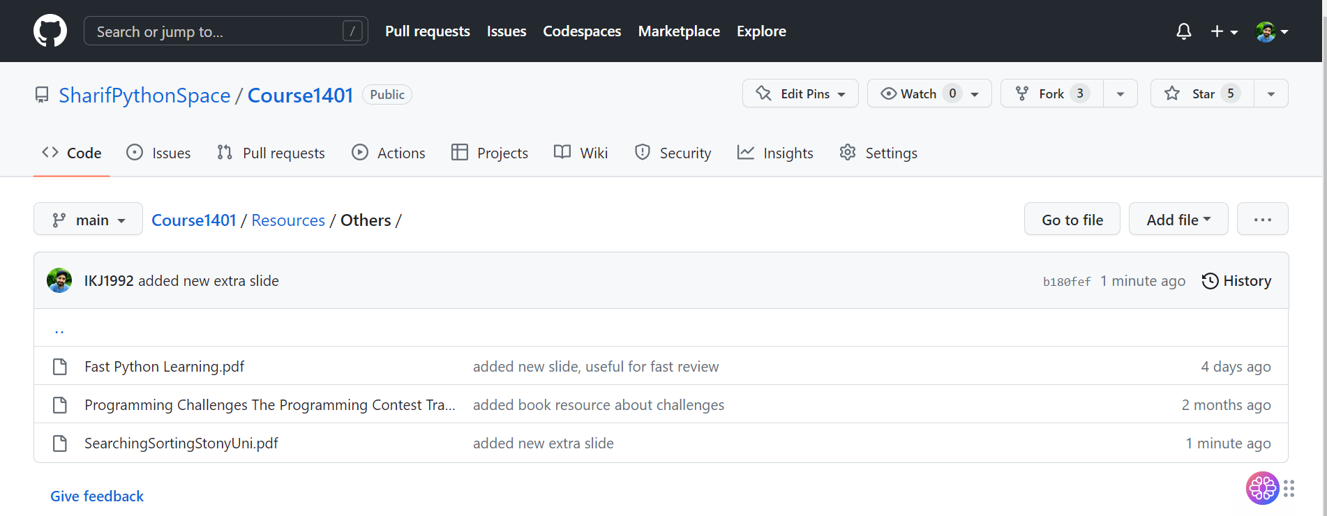
Check it!

Slide 9

Library: sort and search

Slide 10
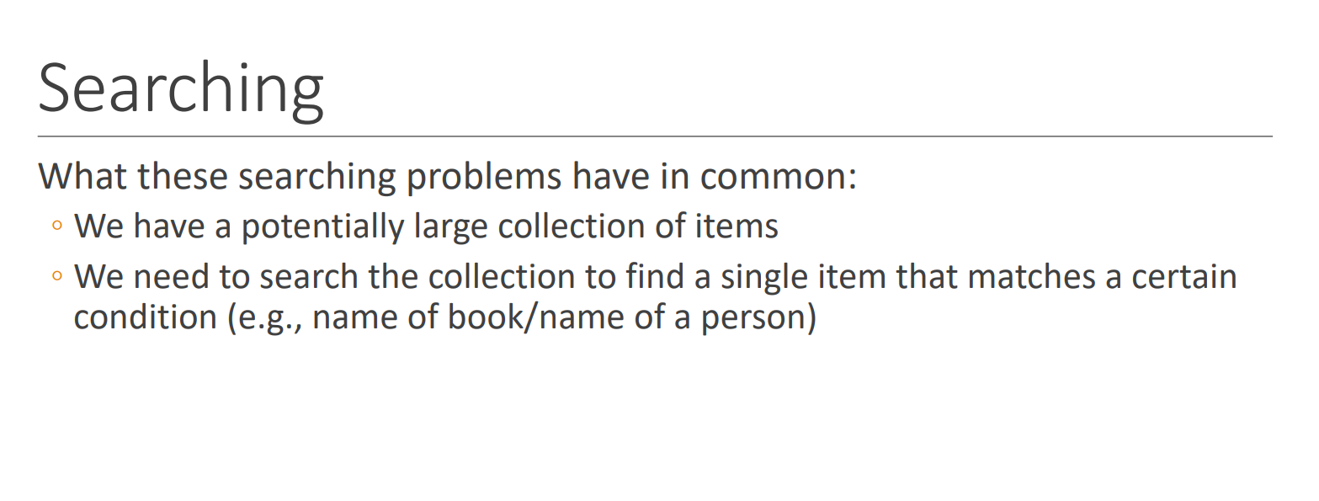
Searching…

Slide 11
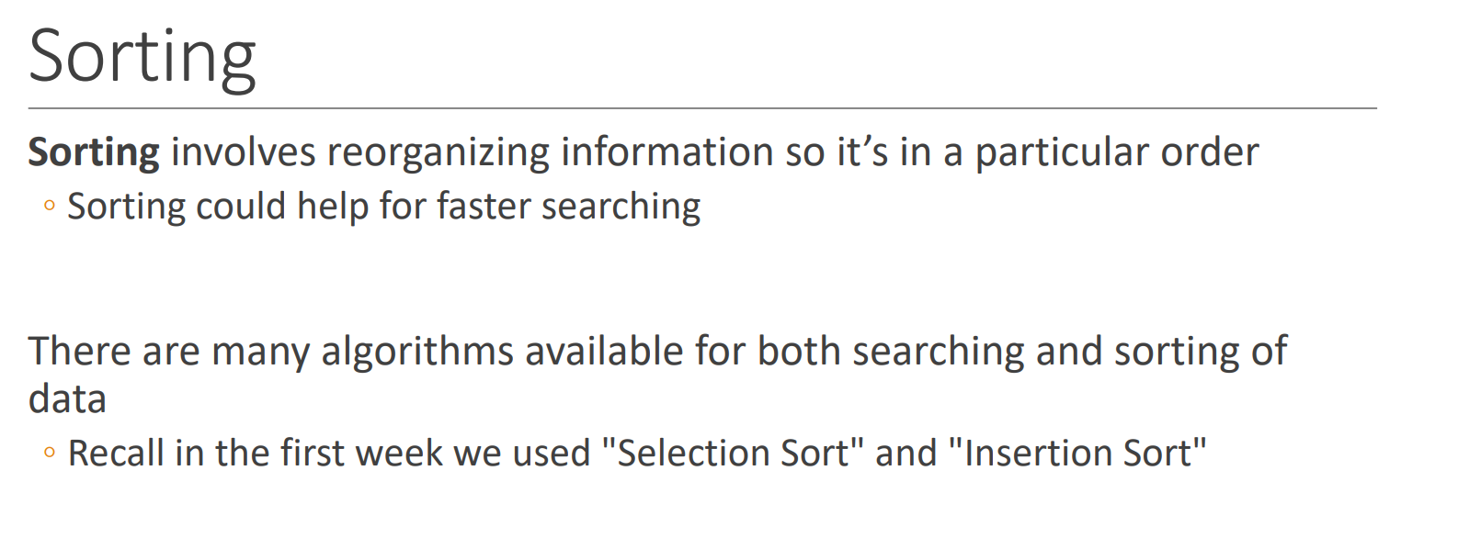
Sorting

Slide 12
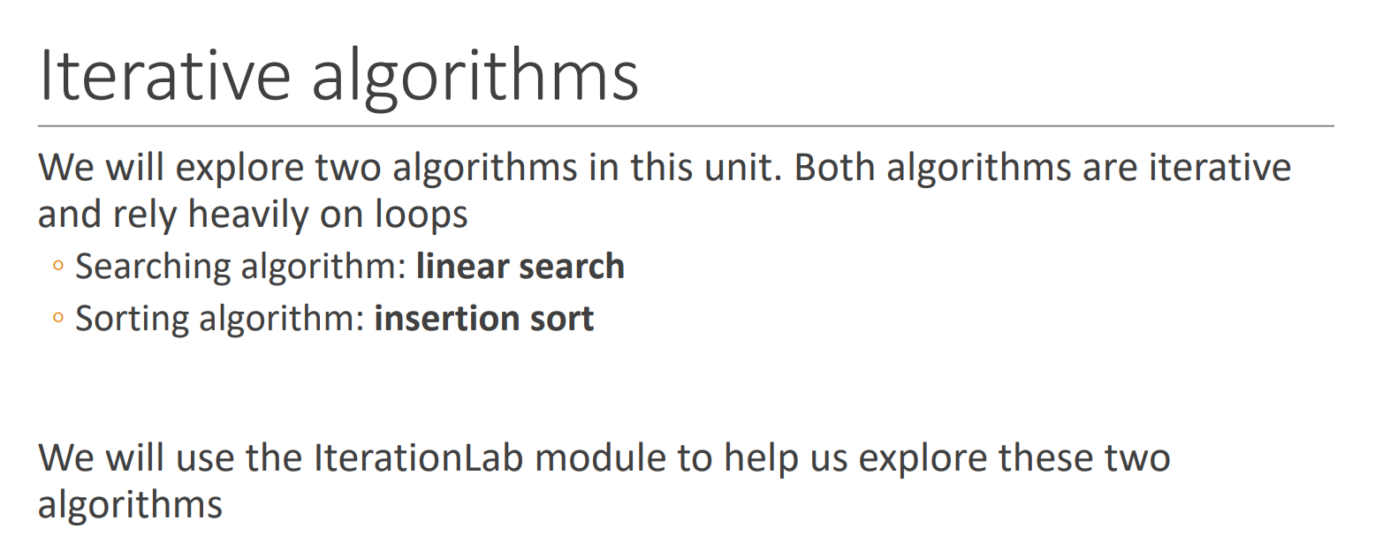
Iterative algorithms!

Slide 13
Talking about exceptions and errors from Dr. Nowzari

Slide 14
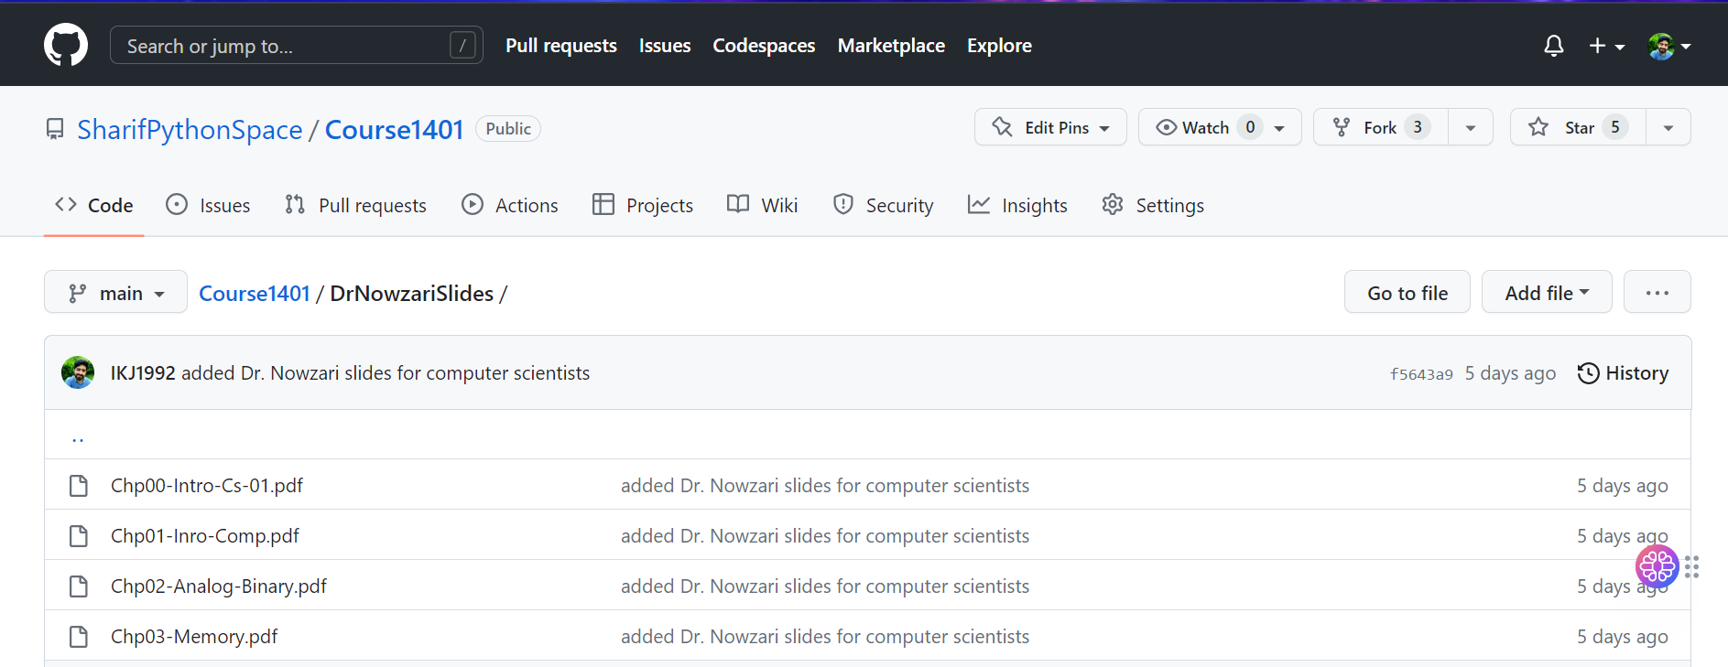
Let’s read it with each other!

Slide 15

به گردن ما حق دارن...

Slide 16
Application of Programming in the Digital Age!

Slide 17
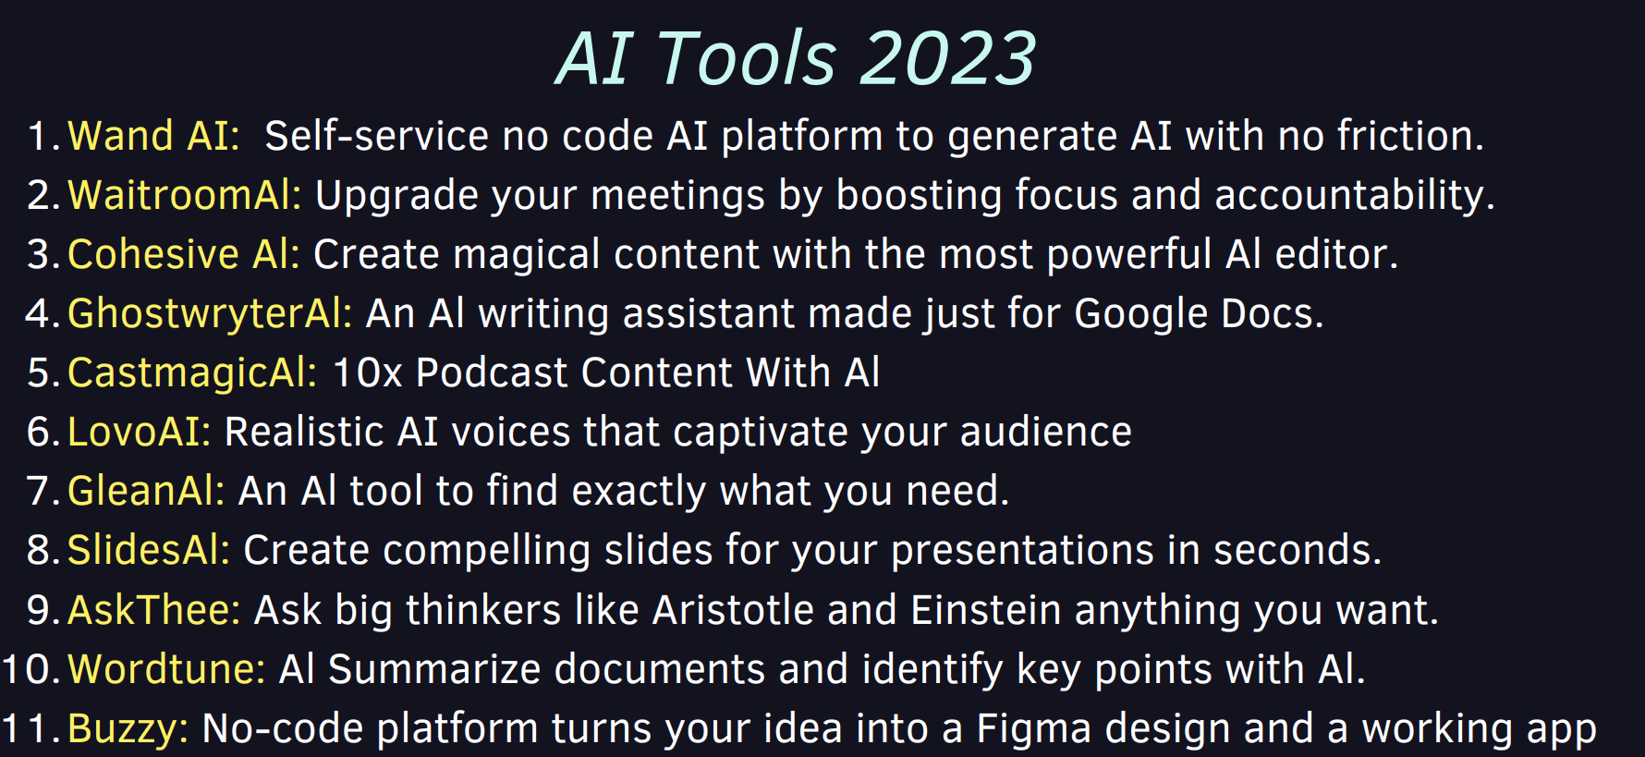
AI Tools 2023

Slide 18
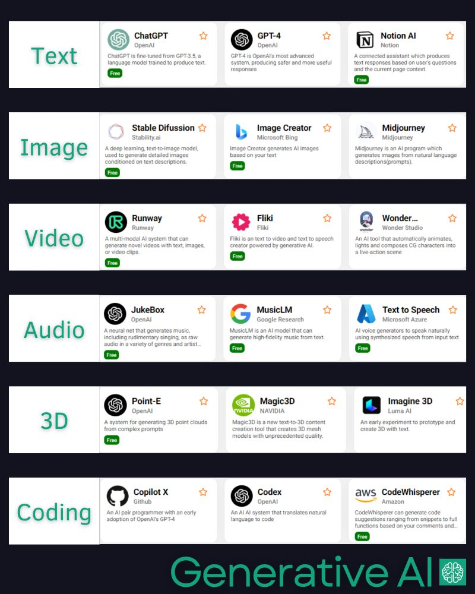
AI can generate, like humans!

Slide 19

با این همه کاربردهای مختلف که تا الان گفتم، باز هم ایده برای پروژه پایان ترم نداری؟!؟!
نترس، کنجکاو باش، آرزو کن، شجاع باش، قدم بردار، آیندت رو بساز، آینده رو بساز

Slide 20
Lecture Resources

